Slide 1


Data Analysis Final Project:
The Office Dataset
Presented By: Jenny Ha & Patrick Walsh
Class: IST 652
Professor: Dr. Landowski
Date: 6/9/2023

Slide 2

Agenda
Project Thesis
About the Dataset
Word Cloud
Method of Analysis
Questions being answered
Conclusions
References
Q&A

Slide 3
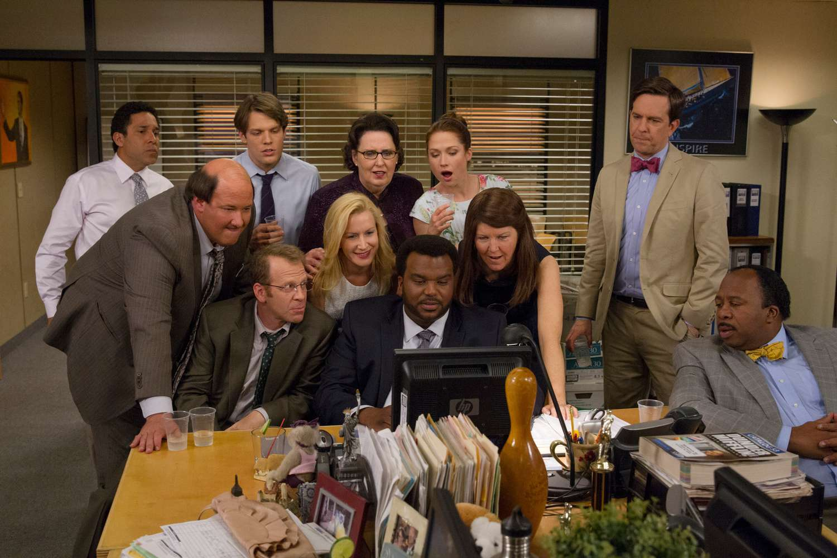
Project Thesis
Using Python, Natural Language Processing (NLP), statistics, and Machine Learning, we can derive valuable insights into the TV show The Office through analysis of its script containing all lines of dialogue used by every character in the show.

Slide 4
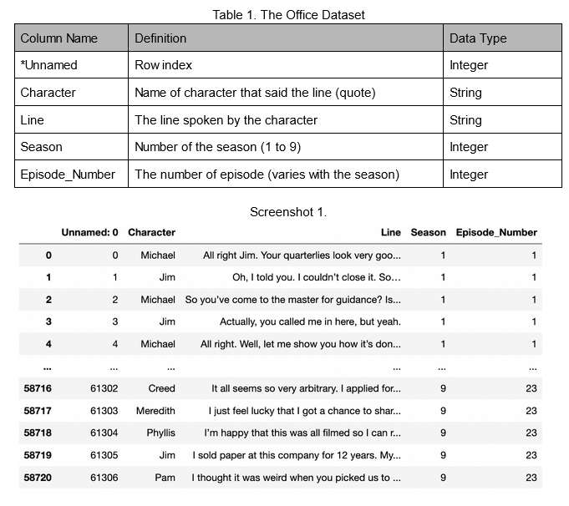
About the Dataset
Dataset consists of 58k rows across 5 columns
Contains scripts for all seasons (1-9) of the TV show The Office
Open source (Kaggle)
Requires minimal preprocessing

Slide 5
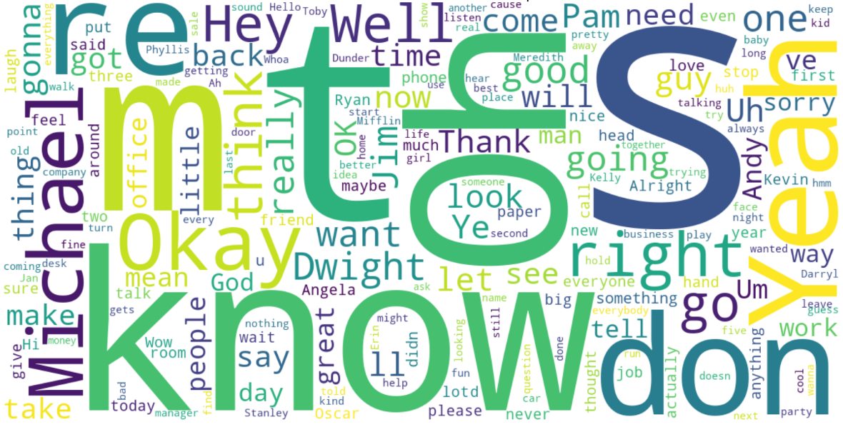
Word Cloud

Slide 6
Method of Analysis
Descriptive statistics for questions 1 and 2
Columns used: “Line” and “Character”
Q1 expected outcome: character that said the most word overall
Q2 expected outcome: characters that said the most words per season
Naive Bayes ML algorithm for question 3
Columns used: “Line” and “Character”
Train model to classify the line said to correct character
Expected outcome: accuracy score and confusion matrix
Flair sentimental analysis model for question 4
Built-in sentiment analysis capabilities to produce score
Analyze script, line by line, etc.
Expected outcome: determine overall tone and score

Slide 7
Method of Analysis
Python Built-In functions for Q5
Parse lines, group line by characters, and count number of lines
Expected outcome: highest and lowest count of lines by characters
N-gram Analysis for Q6
Scikit-Learn library to count N-gram of 4 & 5
Identify phrases from “Michael”
Expected outcome: Identify common phrases

Slide 8
Questions being answered
Q1. Which character said the most words in the TV show overall?
Q2. Which character said the most words per season?
Q3. Can the main character be determined by the dialogue?
Q4. What is the overall tone of the TV show in terms of its script?
Q5. Which characters have longer lines and which have shorter lines?
Q6. What are the top phrases used by the main character?

Slide 9
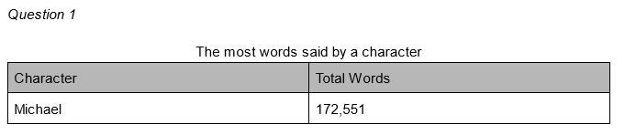
Q1. Which character said the most words in the TV show overall?

Slide 10
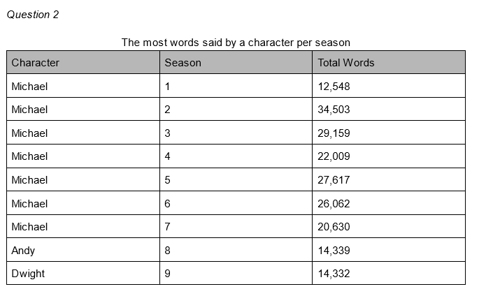
Q2. Which character said the most words per season?

Slide 11
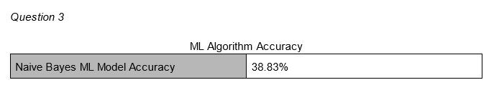
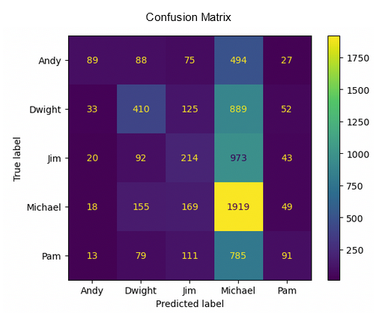
Q3. Can the main character be determined by the dialogue?
Scikit Learn: Naive Bayes
Classification algorithm
Transform text into matrix of token counts
Data: Train 80 / Test 20

Slide 12
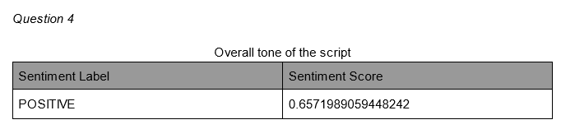
Q4. What is the overall tone of the TV show in terms of its script?
Script tone determined by sentiment analysis
Flair model used built-in sentiment analysis processes
Input: raw text; output: sentiment label + sentiment score

Slide 13
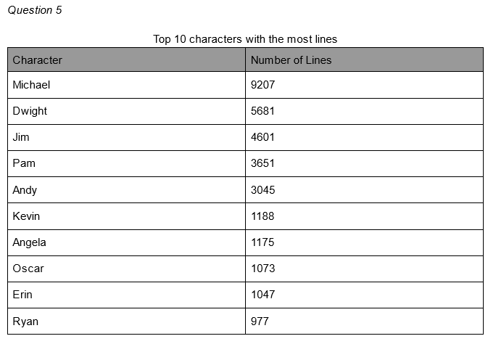
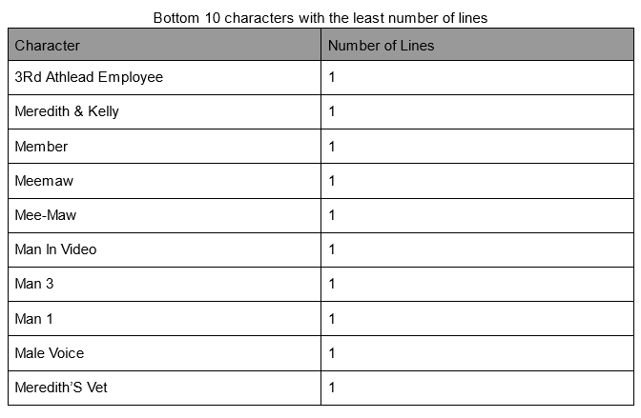
Q5. Which characters have longer lines and which have shorter lines?

Slide 14
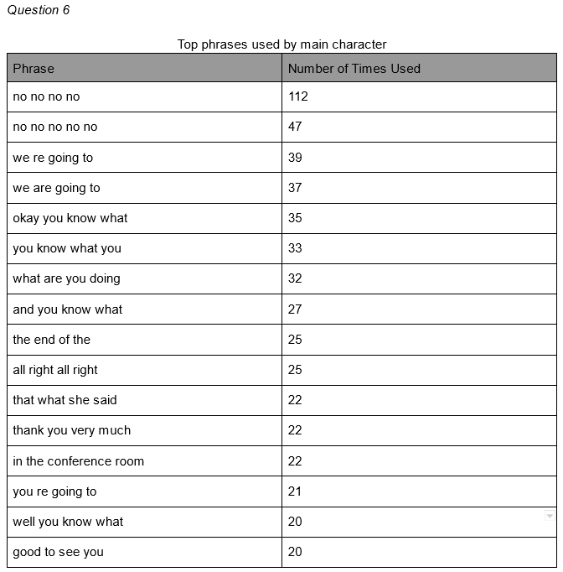
Q6. What are the top phrases used by the main character?
N-gram analysis used to find 4-5 word phrases
Analysis isolated to main character
SciKit-Learn library leveraged using CountVectorizor() method
Stopwords retained for sentence integrity

Slide 15
Conclusions
Michael said the most words at 172,551 words
Season 1-7 Michael said the most words, Season 8 is Andy, & Season 9 is Dwight
Naive Bayes ML model accuracy score is 38.83%
Confusion matrix showed over prediction for Michael & under predicted other characters
Tone of the script overall was positive, with rating of 65.7%
Analysis revealed a large number of characters with only one line
Main characters like Michael, Pam, and Jim had several thousand lines
N-gram analysis revealed phrases such as “in the conference room” and “that’s what she said”
Michael established as main character of show, based on word/line counts

Slide 16
References
Cominetti, F. (n.d.). The Office Lines. Kaggle. Retrieved May 29, 2023, from https://www.kaggle.com/datasets/fabriziocominetti/the-office-lines?datasetId=1807639&select=the-office_lines.csv
OfficeQuotes.net. (n.d.). Welcome to OfficeQuotes.net. OfficeQuotes.net. https://www.officequotes.net/

Slide 17

Questions?

